Slide 1
Triangle Partitioning and Linear Optimization of Forward Lines
Chris Kang
shinwook@uw.edu
University of Washington
NESSIS 2015

Slide 2
Motivation
Objective of a coach is to “win a hockey game” by:
  Finding “chemistry” between players
  Finding “balance” among the lines (allocating appropriate Time on Ice)
  Matching up against opposing lines
Question: How can you analytically answer all these questions at once?
Proposed Solution: A variation of team level With or Without You (WoWY) analysis (Triangle Partitioning)

Slide 3
Idea
Traditional idea of finding chemistry between two players is to apply WoWY analysis
Works well in the case of finding defensive pairs:
  Compare and contrast all possible defensive pairings
What about forward lines?
  We can try David Johnson’s SuperWoWY*
  However, most teammates do not get to play on all possible lines, thus, sample size is too small for any analysis
  *www.puckanalytics.com

Slide 4
Triangle Partitioning
Key Concept: Use implicit WoWY stats – triangle of players
Instead of looking for data where three players (3-tuple) are on the ice at the same time, use a chain of WoWY between two players
Example:
Line1 = {Sidney Crosby, Patric Hornqvist, David Perron}
Crosby & Hornqvist - 54.9 CF%
Crosby & Perron – 58.8 CF%
Hornqvist & Perron – 56.8 CF%
=> Implicit CF% of Line1 - 56.83 CF%

Slide 5
Triangle Partitioning
Generalization for all 4 Lines:
Let V = {player₁, player₂, player_{3, …..,} player₁₂}
Then, E={e_{1,} e_{2,} e_{3, ….,} e }
where e_{n} is some statistical measurement between two players (i.e. CF%)
Then, consider all partitioning of the lines into 4 triangles.

Slide 6
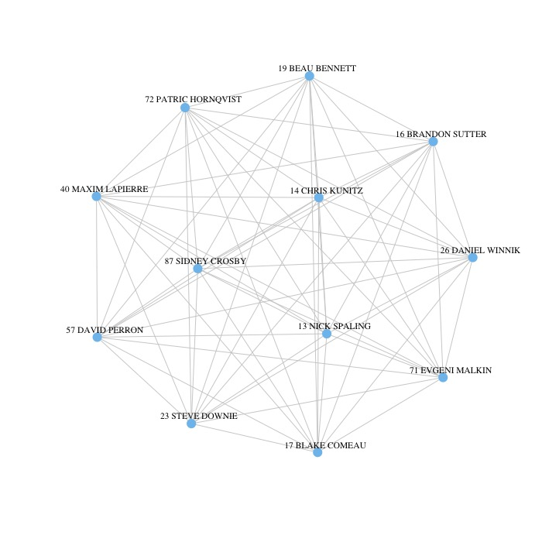
Triangle Partitioning

Slide 7
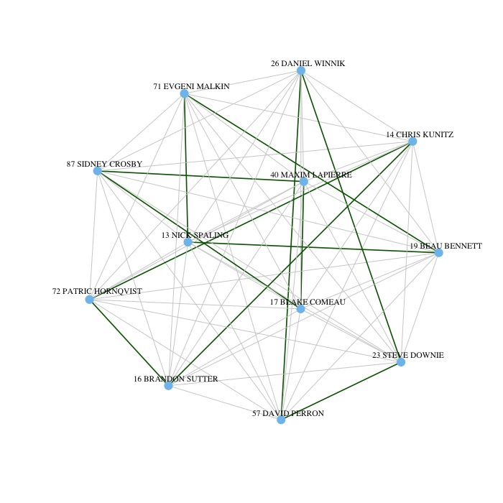
Triangle Partitioning

Slide 8
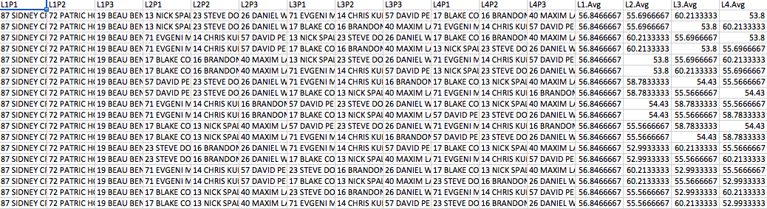
Data

Slide 9
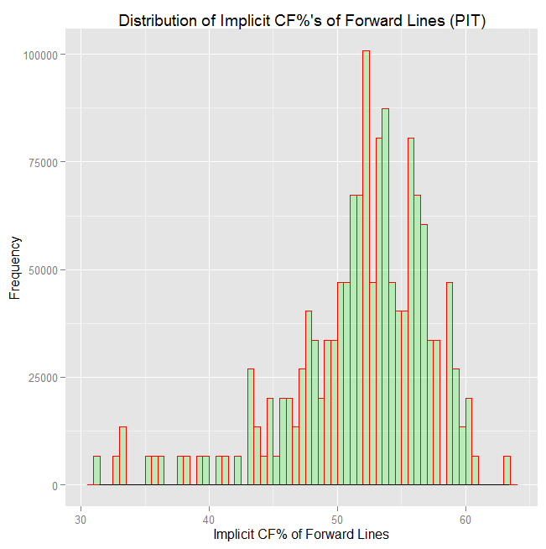
Triangle Partitioning
Notes:
[Distribution of Data] Explain Skewed Distribution, Median, and quantiles etc… Really corroborates well with team-wise CF%, and
Median is at 52.515 CF%

Slide 10
Triangle Partitioning
Average Line Rank – “Gellability”
Player | Average Rank
87 SIDNEY CROSBY | 1.846753
57 DAVID PERRON | 2.003247
26 DANIEL WINNIK | 2.311688
17 BLAKE COMEAU | 2.329221
19 BEAU BENNETT | 2.41039
72 PATRIC HORNQVIST | 2.45974
71 EVGENI MALKIN | 2.462338
14 CHRIS KUNITZ | 2.576623
13 NICK SPALING | 2.677922
16 BRANDON SUTTER | 2.733117
23 STEVE DOWNIE | 2.894805
40 MAXIM LAPIERRE | 3.292208

Slide 11
Application: Optimization
With the implicit line data available for all possible configurations, we compute the optimal Time on Ice (TOI) to determine the “best” balanced lines.
Linear Programming Setup:
  Maximize
  Team_CF% = t₁L₁ + t₂L₂ + t₃L₃ + t₄L₄
  With Constraints:
  t₁ + t₂ + t₃ + t₄ = 1
  0 < t₁ ≤ ⅓
  0 < t₂ ≤ ⅓
  0 < t₃ ≤ ⅓
  0 < t₄ ≤ ⅓
Notes:
Want to answer the question of “Balance.” This is an important process. Compare two scenarios, where all 4 lines are “balanced,” 52CF%. There is a chance that this is gonna perform poorly when in another case Line 1 has extremely high CF% and Line 4 could has extremely low CF%.

Slide 12
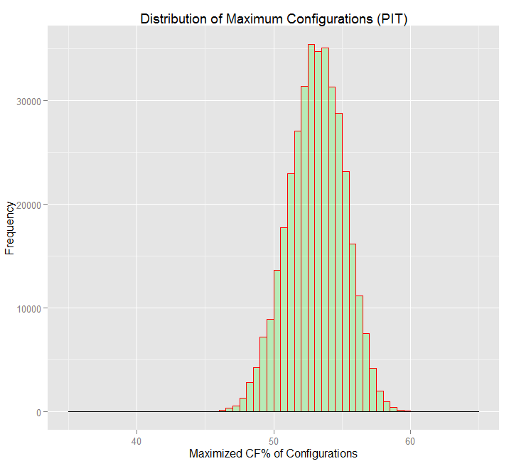
Distribution of Optimal Configuration
Notes:
52.7% overall last year, but also, 54.2% if you play around with Time on Ice, it still doesn’t make too much of a difference.

Slide 13
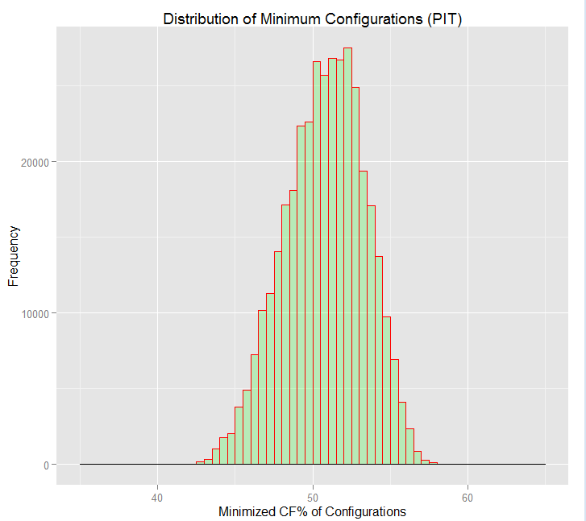
Distribution of Not-So-Optimal Configuration

Slide 14
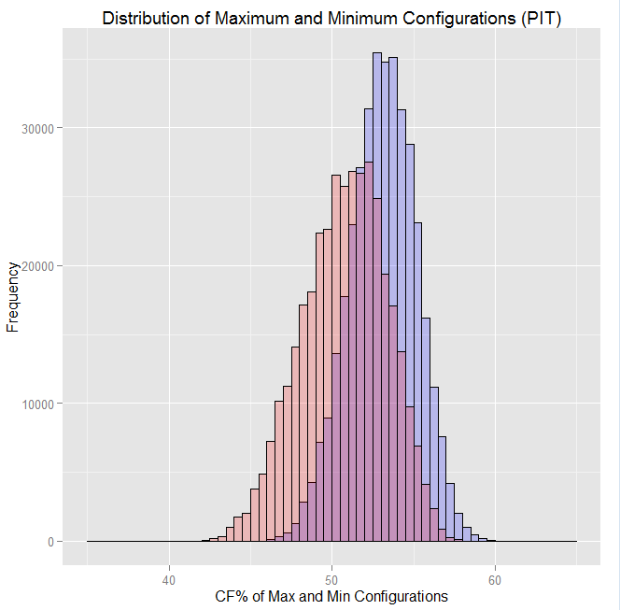
Distribution…

Slide 15
Summary
With the Triangle Partitioning idea, we can assess the chemistry of the entire lineup
We can analyze the upper and the lower limit of a team CF%
We can analyze the optimal allocation of Time on Ice for the 4 forward lines
Brandon Sutter is not a good player

Slide 16
Thank You!
Email: shinwook@uw.edu

