Slide 1
Football under Pressure:
Assessing Malfeasance in Deflategate
Stan Veuger
American Enterprise Institute

Slide 2
Alleged Malfeasance
Indianapolis Colts and NFL accuse New England Patriots of cheating
Supposedly deflated footballs before AFC Championship game
Initial reports: 11 out of 12 footballs 2.0 psi below minimum
Drawn-out legal and media drama ensues

Slide 3
Timeline
January 18: AFC Championship Game
    Colts – Pats 7-45
May 6: Wells Report Released
May 11: Goodell Punishes Brady, Patriots
June 23: Brady Appeal Hearing
July 28: Goodell Upholds Sanctions
September 3: Federal Judge Vacates Sanctions

Slide 4
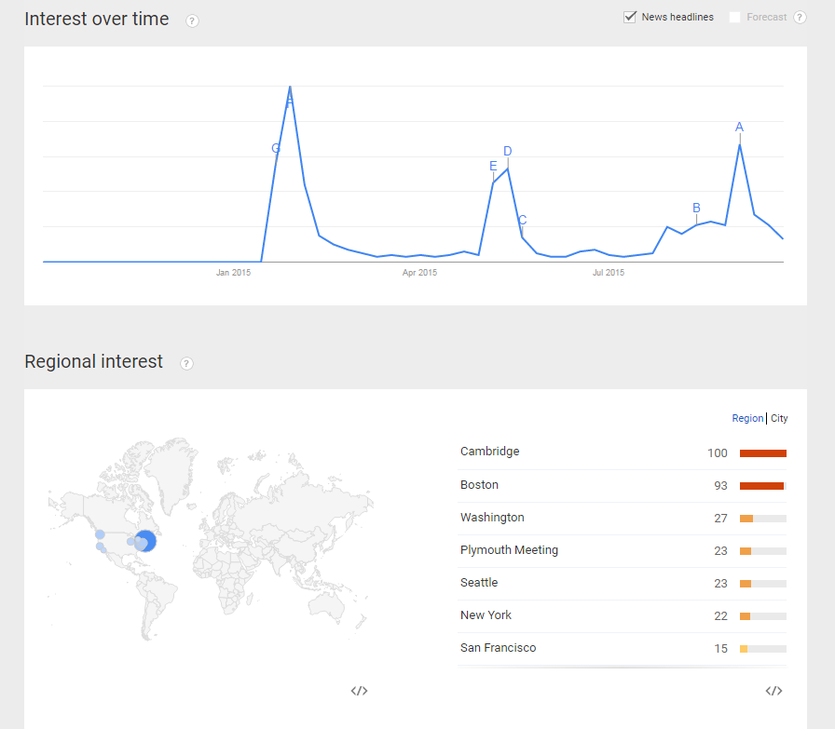
Timeline

Slide 5
Wells Report
NFL hires Ted Wells et al. to carry out “independent” investigation
Find that Tom Brady was at least “generally aware” of what was deemed to be “more probable than not” illicit behavior
Brady guilty under preponderance of the evidence standard
Based on experimental, statistical, and other circumstantial evidence

Slide 6
Statistical Analysis
Question is whether Patriots footballs were anomalously deflated
Difference-in-difference estimator using halftime measurements and assumptions about pre-game inflation levels:
    PressureDrop_{ij} = α + βd_{i} + ϵ_{ij}
Data quality extremely poor

Slide 7
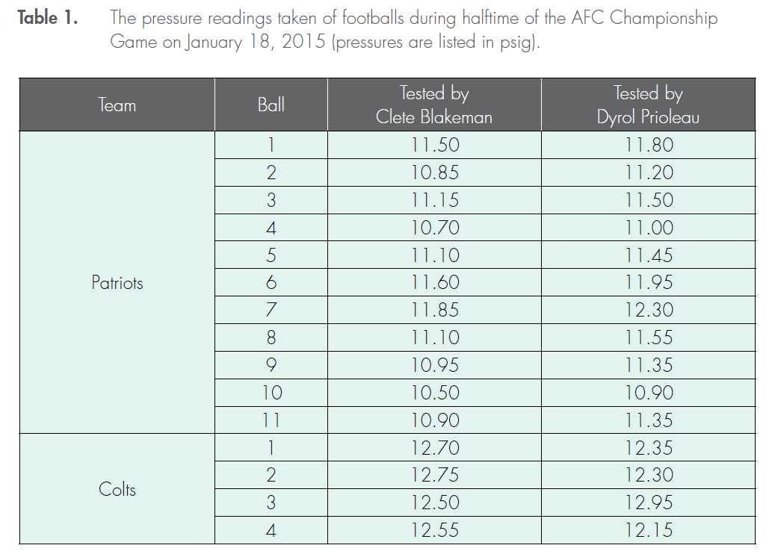
Halftime Data

Slide 8
Sources of Uncertainty
Gauges used before the game
Lack of recordkeeping before the game
Gauges used at halftime
Recordkeeping at halftime
Timing of measurements
Everything after the game
Intercepted football

Slide 9
Sources of Uncertainty
Gauges used before the game
Lack of recordkeeping before the game
Gauges used at halftime
Recordkeeping at halftime
Timing of measurements
Everything after the game
Intercepted football

Slide 10
Dif-in-Dif Estimates
1) Official Blakeman (“Official 1”) used the Non-Logo Gauge for all 15 of his measurements, while official Prioleau (“Official 2”) used the Logo Gauge for all 15 of his measurements
2) As in 1), but assuming that the officials switched gauges after measuring the 11 Patriots footballs
3) As in 2), but assuming that the measurements produced by the two officials for the third Colts football were written down in the wrong column
4) As in 2), but without taking the measurements of the third Colts football into account

Slide 11
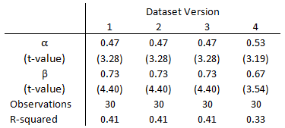
Dif-in-Dif Estimates

Slide 12
Sources of Uncertainty
Gauges used before the game
Lack of recordkeeping before the game
Gauges used at halftime
Recordkeeping at halftime
Timing of measurements
Everything after the game
Intercepted football

Slide 13
Pre-Game Gauge Uncertainty
Non-Logo Gauge for both teams
Non-Logo Gauge for Patriots only
Non-Logo Gauge for Colts only
Logo Gauge for both teams
Logo Gauge measurements are .3 - .4 psi higher.

Slide 14
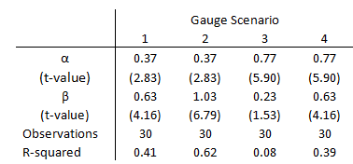
Pre-Game Gauge Uncertainty

Slide 15
Sources of Uncertainty
Gauges used before the game
Lack of recordkeeping before the game
Gauges used at halftime
Recordkeeping at halftime
Timing of measurements
Everything after the game
Intercepted football

Slide 16
Timing Controls
PressureDrop_{ij} = α + β₁d_{i} + β₂CP_{i} + β₃CC_{i} + ϵ_{ij}

Slide 17
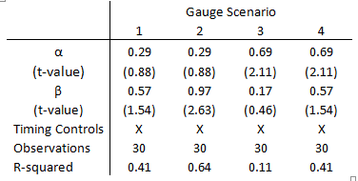
Timing Controls

Slide 18
Sources of Uncertainty
Gauges used before the game
Lack of recordkeeping before the game
Gauges used at halftime
Recordkeeping at halftime
Timing of measurements
Everything after the game
Intercepted football

Slide 19
Simple Difference
Expected range: 11.32 – 11.52 psi
Non-Logo Gauge: Insignificant excess deflation
Logo Gauge: No excess deflation

Slide 20
Sources of Uncertainty
Gauges used before the game
Lack of recordkeeping before the game
Gauges used at halftime
Recordkeeping at halftime
Timing of measurements
Everything after the game
Intercepted football

Slide 21
Intercepted Football
Measured three times: 11.52 psi

Slide 22
Conclusions
Lack of robustness
What is the prior?
Protocol
Data collection

